Slide 1
STUDY SYNC WEBSITE
Batch Number: 08
Team Member Names and roll number
21R11A1204 : BANDELA PREM KUMAR
21R11A1212 :DANDEMPALLI RAKESH
21R11A1231: KORRA HEMANTH NAIK
21R11A1249: SABAVATH SIDDU
Under the guidance of
Mrs K Gnana Mayuri
Assistant Professor

Slide 2
Abstract
For students in the class, it is not easy to get all the information about the class in one place. If a student is absent, they need to ask their friends for notes. Sometimes, they cannot take notes or miss a class due to personal problems or events, and it becomes difficult for them to know the topics covered on a particular day. Also, students are not aware of their daily attendance. To overcome all these problems, we have developed a solution called 'Study Sync Website' to help students access and manage all their classroom information in one place. With Study Sync, students can easily view their class schedules, check the topics covered on a particular day, access subject-wise notes, and keep track of their attendance. With Study Sync, organizing and managing classroom information becomes easier. The website is applicable for a single section only.

Slide 3
Introduction
Traditional classroom information management can be challenging for students who miss a class or have personal problems.
Students may have to rely on their classmates for notes or information, which can be time-consuming and unreliable.
The 'Study Sync Website' has been developed to address these issues.
The website provides students with a one-stop solution for all their classroom information needs
Students can access their class schedules, view the topics covered on a particular day, access subject-wise notes, and keep track of their attendance.
Study Sync makes managing classroom information easier and more organized.
The website is designed for a single section, providing a personalized learning experience for students.

Slide 4
Existing System
In the existing system, all section notes are available, but it can be challenging for students to find notes specific to their subjects, making it difficult to stay organized and up-to-date.
While the existing system allows students to check their overall attendance percentage, there is no day-to-day tracking available, which can make it hard for students to keep track of their attendance and stay on top of their studies.
Although all the topics are available in the existing system, it can be difficult for students to know which topic is being covered on a particular day, which can cause confusion and make it harder for them to prepare for class.
While the existing system provides information about the whole college, it does not offer information about individual sections, which can make it challenging for students to find the specific information they need
Students cannot find their class timetables and faculty contact numbers on the college website, making it harder for them to plan their schedules and contact their professors when needed.

Slide 5
Problems in Existing System
There is no effective way for students to access and manage all their classroom information in one place.
Students can’t keep track of their attendance in every class.
The students who have missed the class struggle to keep up with note-taking during lectures.
There is no efficient and organized information reducing the need for students to rely on their classmates for notes or information

Slide 6
Proposed System
Study Sync will have a user-friendly and intuitive interface that students can easily navigate to access their classroom information. The interface will be designed to provide quick access to class schedules, subject-wise notes, and attendance records.
Study Sync will include a database that stores all relevant information, such as class schedules, notes, and attendance records. The database will be secure and accessible only to authorized users.
Study Sync will provide a feature for attendance management that will allow students to mark their attendance for each class. The system will also generate automated reports to track attendance records.
Study Sync will provide a feature for notes management that will allow teachers to upload subject-wise notes for each class. Students will be able to access and download these notes through Study Sync.

Slide 7
Objectives
To provide a centralized platform for students to manage and organize their classroom information, including class schedules, notes, and attendance.
To provide a centralized platform for students to manage and organize their classroom information, including class schedules, notes, and attendance.
To provide a centralized platform for students to manage and organize their classroom information, including class schedules, notes, and attendance.
To provide a centralized platform for students to manage and organize their classroom information, including class schedules, notes, and attendance.

Slide 8
Hardware Requirements
RAM: 4GB
Laptop, personal computer, mobile, tablet, etc.
Processor: A multi-core processor with a minimum clock speed of 2 GHz.

Slide 9
Software Requirements
OS: Windows 7 & above
Back-end: MYSQL (data base)
Front-end: HTML, CSS & JAVA SCRIPT(JS)

Slide 10
Architecture
Study Sync website
Backend Server
Admin Manages: Notes, Attendance, faculty contacts.
Users Account
Database
Login
Notes ,
Topics,
Attendances
In Database
Users access Notes
Attendances
users

Slide 11
DATA FLOW DIAGRAM
Downloads
Faculty contact Numbers
Admin
Notes
Upload
Topics covered on particular Day
Study Syn
Database
Student
Attendance
Login page

Slide 12
FLOW CHART
Start
Login page
Login details
No
Valid
Yes
Menu
Topics covered on a particular day
Choose
Daily Attendance
No
Yes
Faculty contact numbers
Display
Notes
End

Slide 13
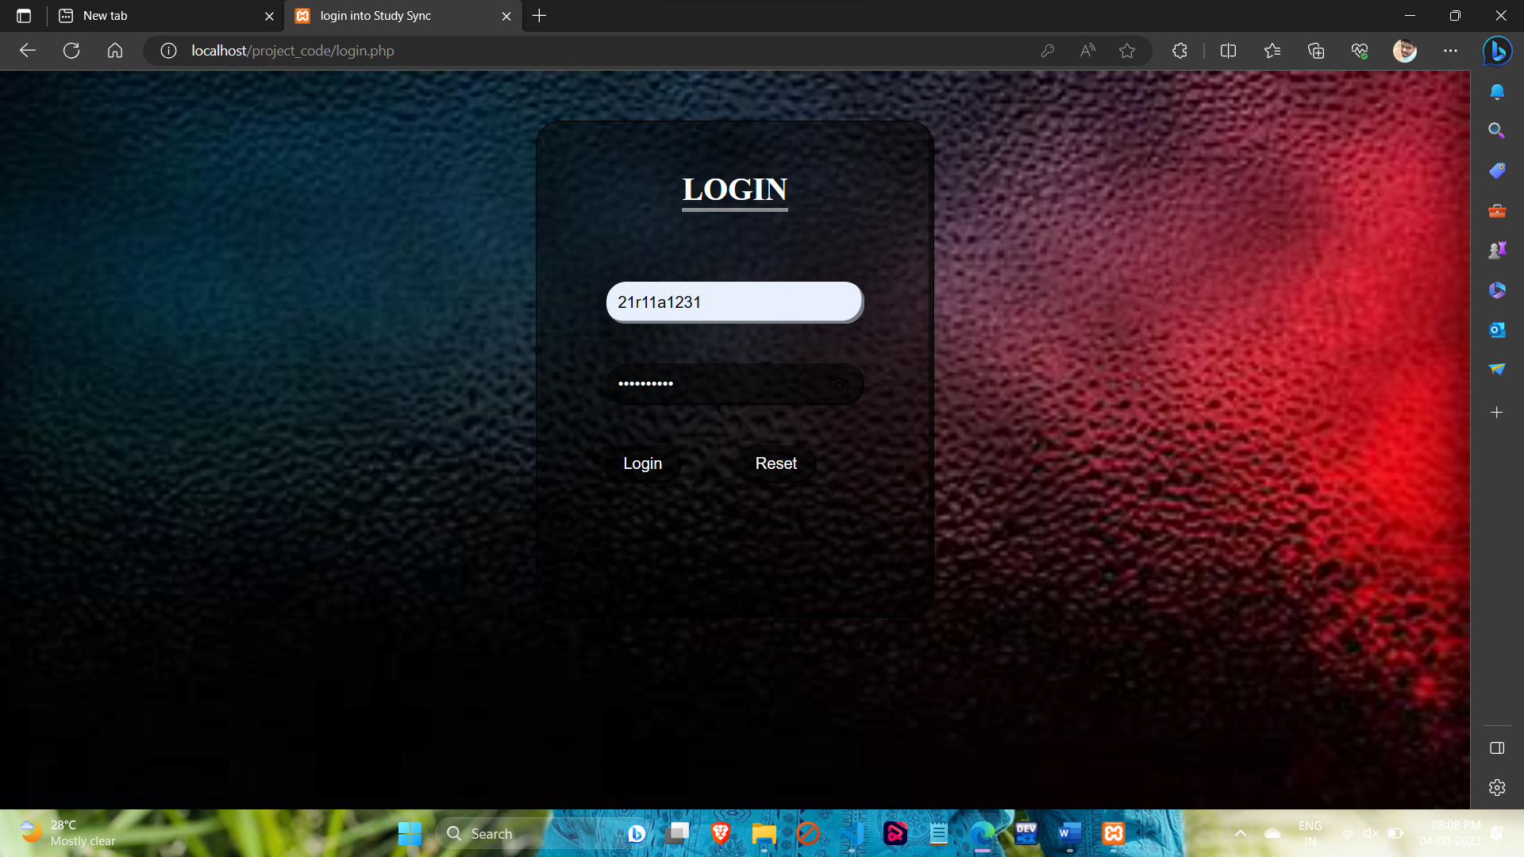
OUTPUT SCREENS LOGIN PAGE

Slide 14
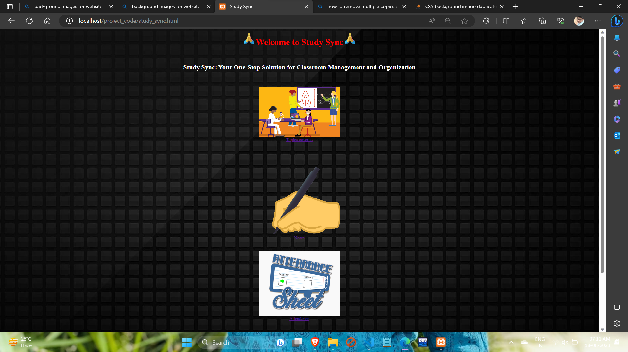
HOME PAGE

Slide 15
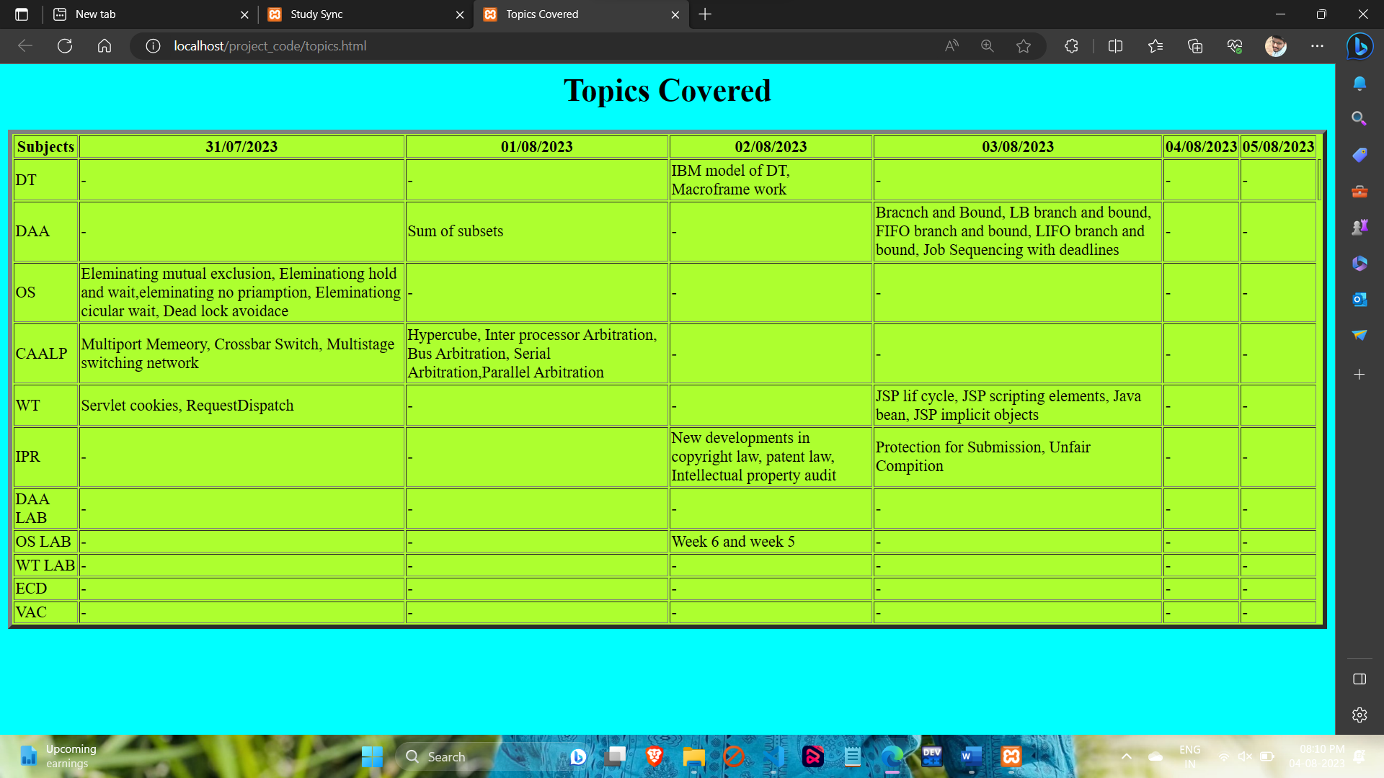
TOPICS COVERED PAGE

Slide 16
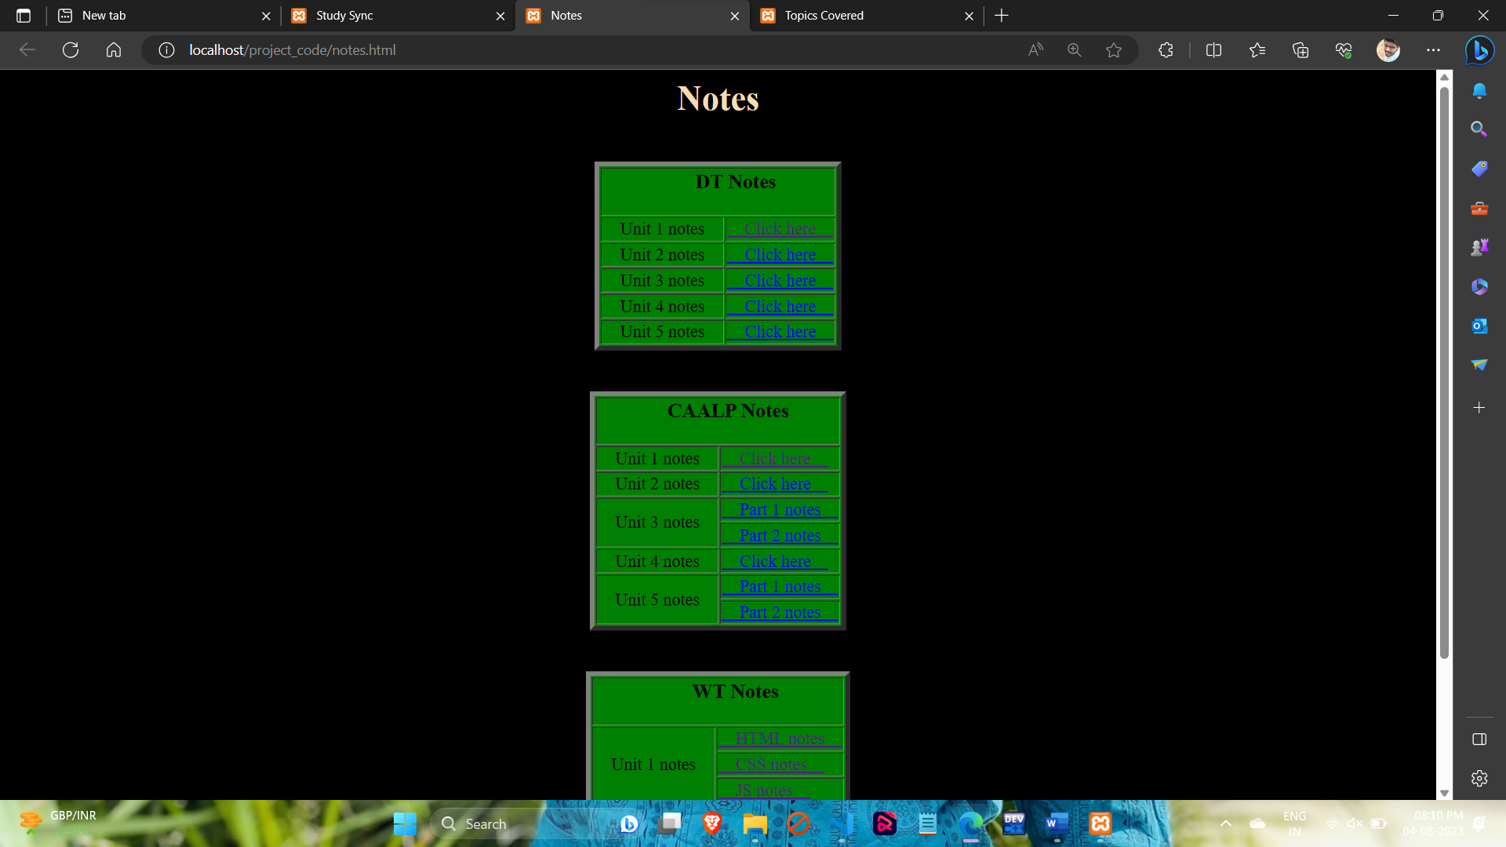
NOTES PAGE

Slide 17
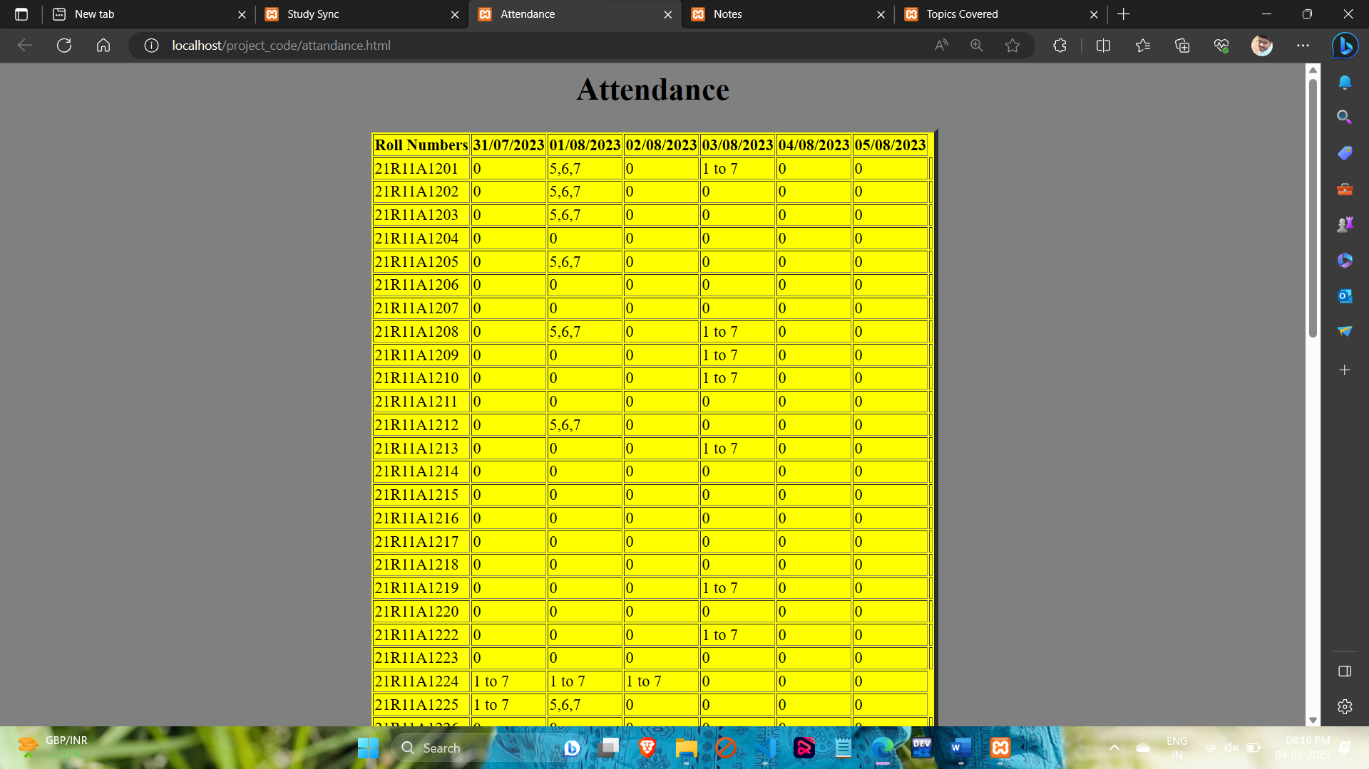
ATTENDANCE PAGE

Slide 18
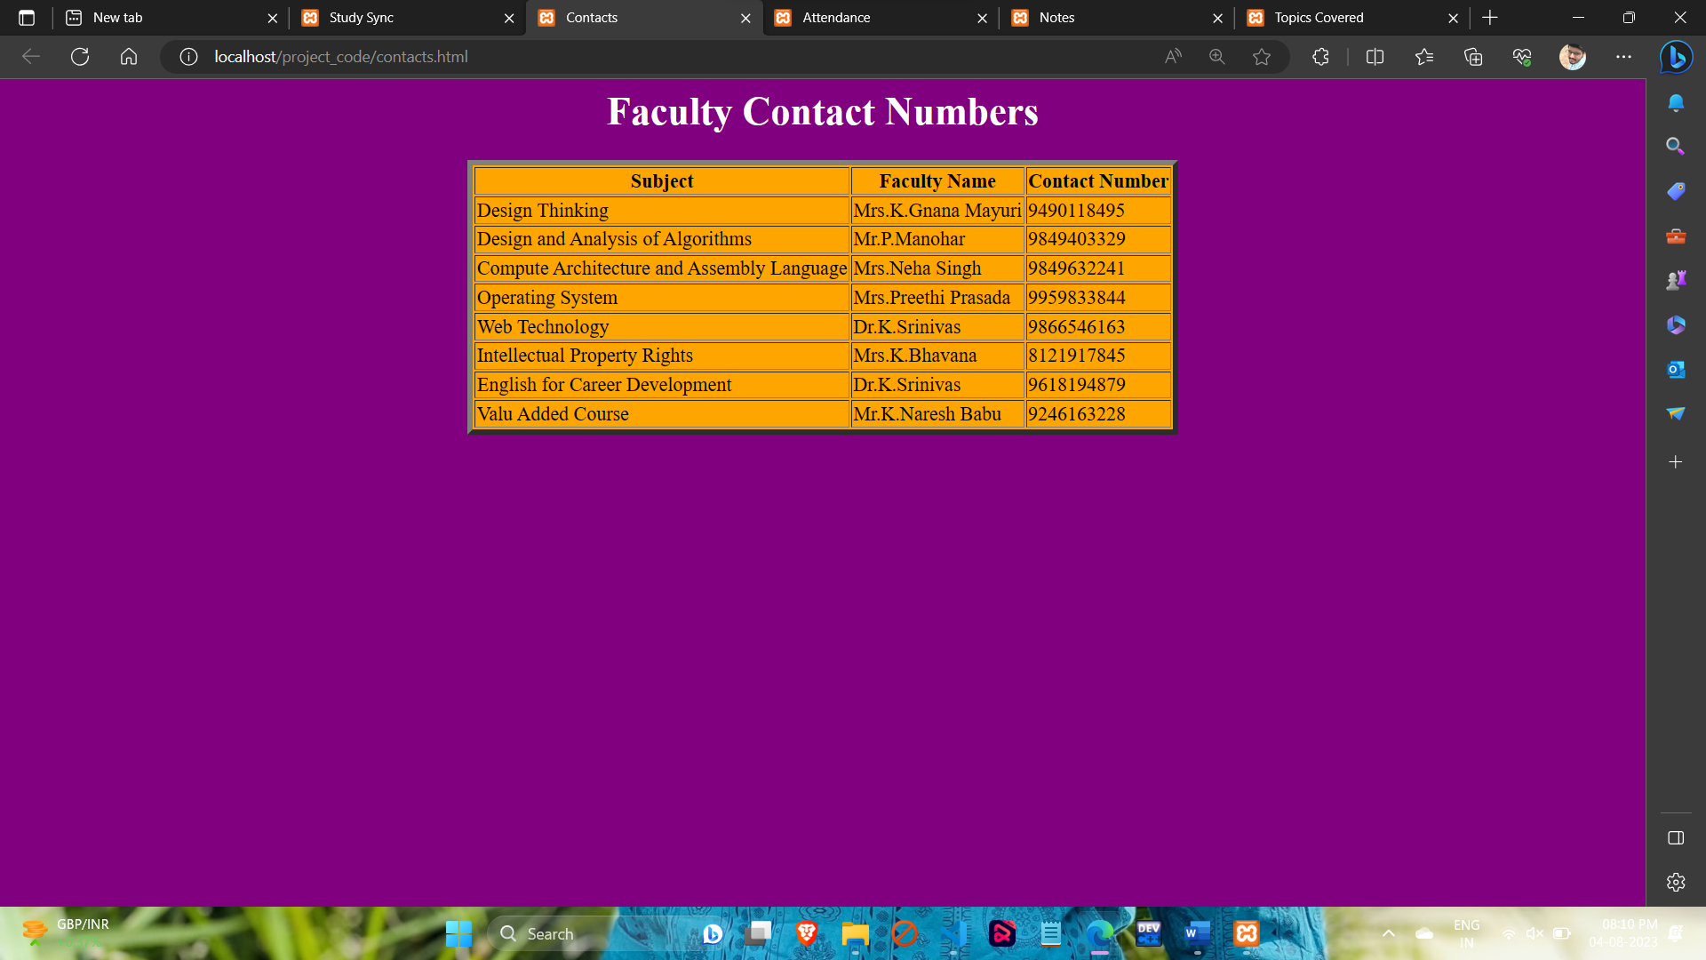
FACULTY CONTACTS PAGE

Slide 19
CONCLUSION
The 'Study Sync Website' project aims to provide students with an efficient and organized platform to access and manage their classroom information. The system addresses the challenges students face in obtaining class schedules, notes, and attendance records in one place. By offering a user-friendly interface, the website empowers students to stay informed and engaged in their studies. The project leverages technologies like HTML, PHP, MySQL, and JavaScript to create a seamless experience for both administrators and students.

Slide 20
THANK YOU

